Slide 1
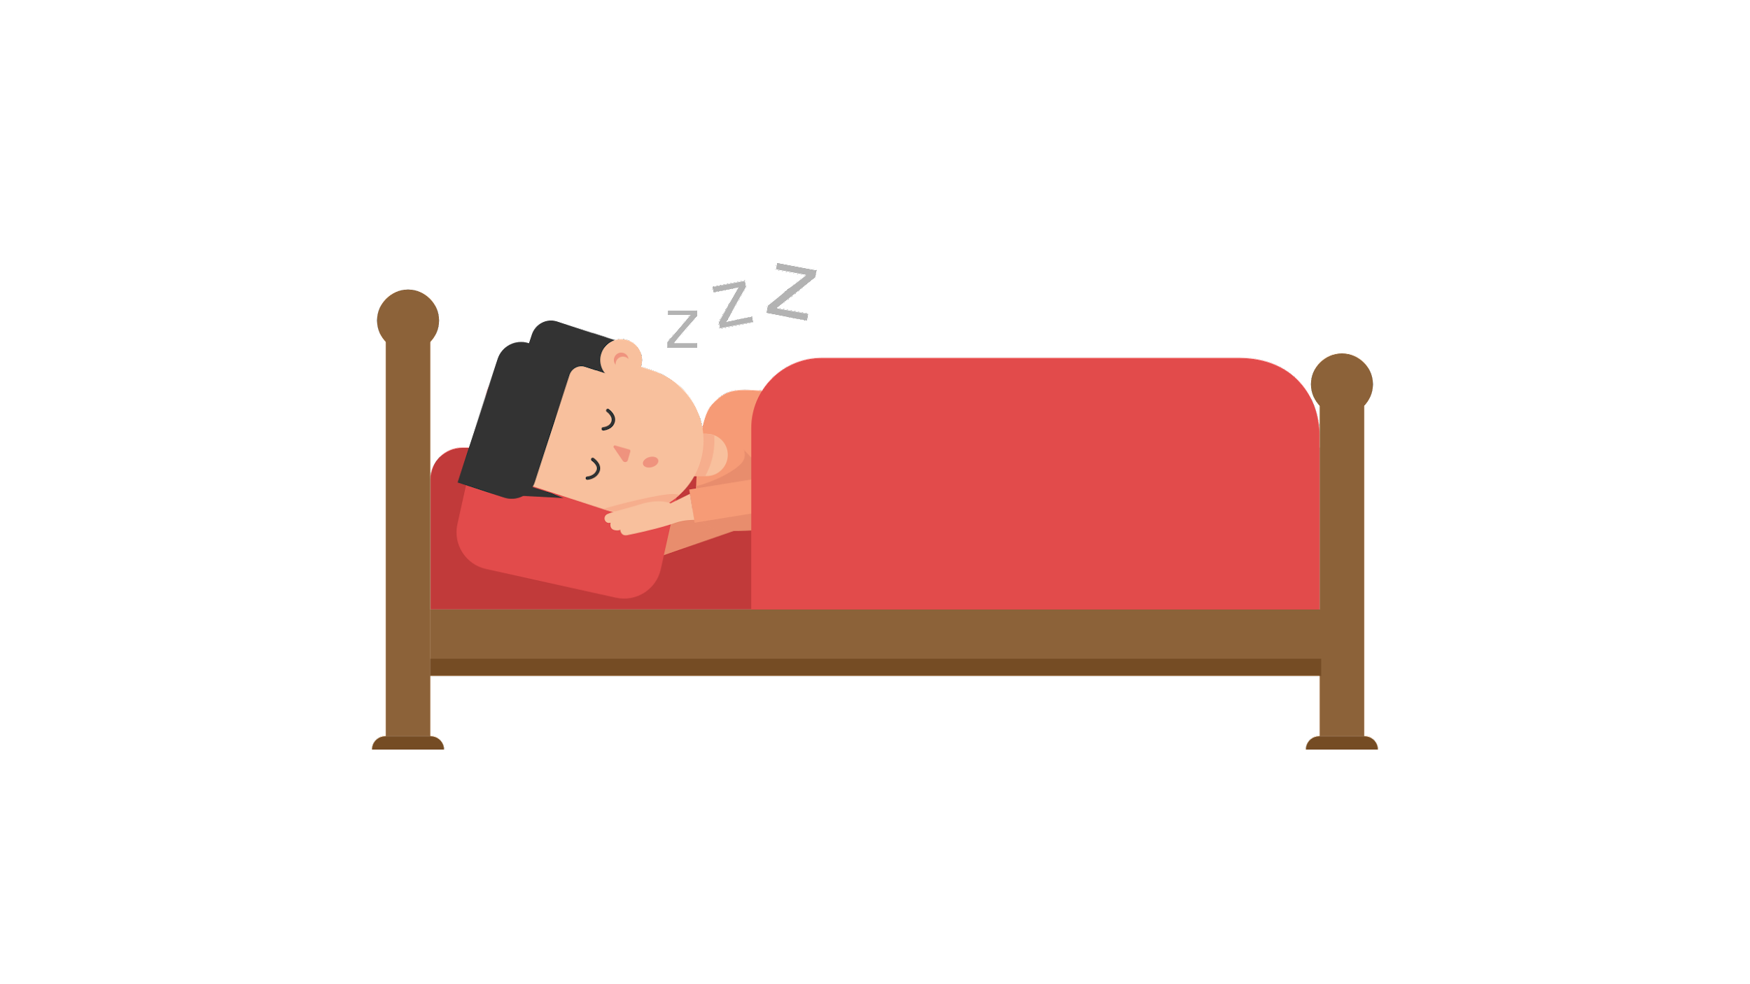
10 Day- Sleep Challenge
Youth

Slide 2
Sleep Challenge Overview:
Step 1: Take the pre-survey (it’s anonymous)
Step 2: Watch the 3.5 min. video “Sleep On It”
Step 3: Look at 1 slide each day for the 10 days of this challenge. It includes a Question of the Day and a short video clip response.
Try one of the suggestions in the video or on the daily slide to improve your sleep. Record your sleep on the daily Google form.
Step 4: At the end of the challenge, take the post-challenge survey (also anonymous)

Slide 3
Step 1: Pre-Survey
Please take the survey below before moving ahead to the next slide
Pre-Sleep Challenge Survey-English
Espanol
Portuguese
K'iche

Slide 4
Step 2: Watch this 3 ½ minute video
https://youtu.be/5z1ew_kpaEw
English
Espanol

Slide 5
Step 3: Do the following, each day of the challenge
Look at 1 slide per day. Each slide includes a Question of the Day and a short video clip response.
Try a suggestion in the original video or on the daily slide to improve your sleep
Record you sleep on the daily Google form

Slide 6
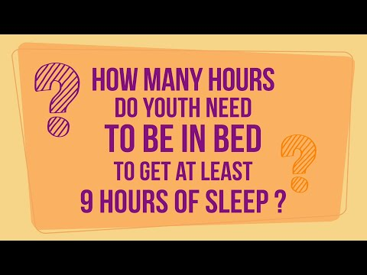
Day 1
Question of the Day
How many hours do you need to be in bed to get at least 9 hours of sleep?
Daily sleep log- English
Espanol
Portuguese
K'iche

Slide 7
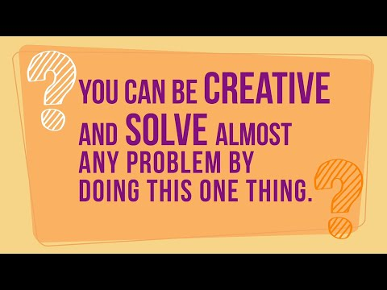
Day 2
Question of the Day
You can be more creative and solve almost any problem by doing this one thing. What is it?
Daily sleep log- English
Espanol
Portuguese
K'iche

Slide 8
Day 3
Question of the Day
How can the brain “see” the outside world if it is inside your skull?
Daily sleep log- English
Espanol
Portuguese
K'iche

Slide 9
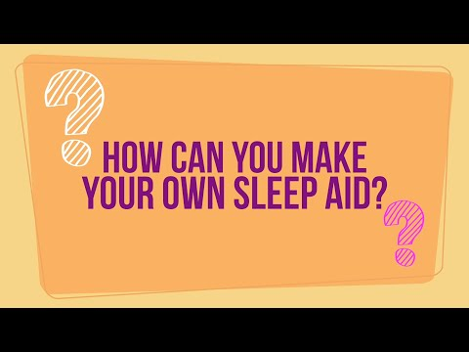
Day 4
Question of the Day
How can you make your own sleep aid?
Daily sleep log- English
Espanol
Portuguese
K'iche

Slide 10
Day 5
Question of the Day
Who makes the best alarm clock? Hint: You can’t buy it in a store.
Daily sleep log- English
Espanol
Portuguese
K'iche

Slide 11
Day 6
Question of the Day
What do coffee, soda, energy drinks, and dark chocolate have in common?
Daily sleep log- English
Espanol
Portuguese
K'iche

Slide 12
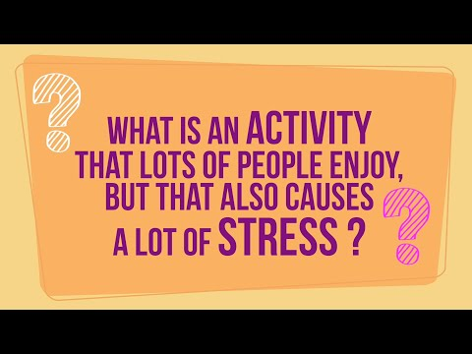
Day 7
Question of the Day
What is an activity that lots of people enjoy, but that also causes a lot of stress?
Daily sleep log- English
Espanol
Portuguese
K'iche

Slide 13
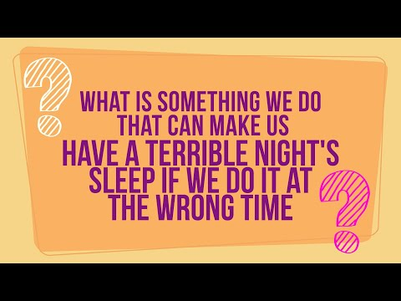
Day 8
Question of the Day
What is an important activity most people do every day but that can make you have a terrible night’s sleep if you do it at the wrong time?
Daily sleep log- English
Espanol
Portuguese
K'iche

Slide 14
Day 9
Question of the Day
Should you nap?
Daily sleep log- English
Espanol
Portuguese
K'iche

Slide 15
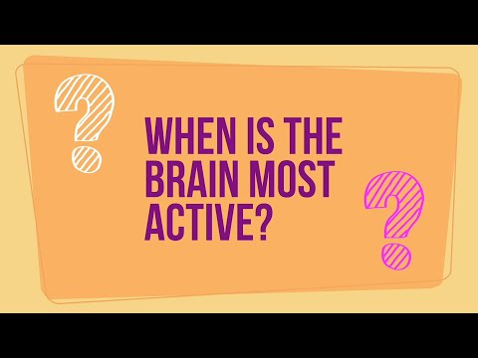
Day 10
Question of the Day
When is the brain most active, during the day or night?
Final Survey- English
Espanol
Portuguese
K'iche

Slide 16
Congratulations! You did it! Thanks for participating!
9 hours of nightly sleep

